Slide 1
What is a plugin?
Plugins are just a layer on top of IoC
Each Plugin has:
A Portable Core
Includes the interface definition
Has PluginLoader.Instance entry point
(optional) Platform extensions
Extensions identified by naming conventions
Each has a Plugin entry point

Slide 2

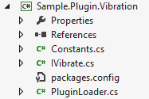
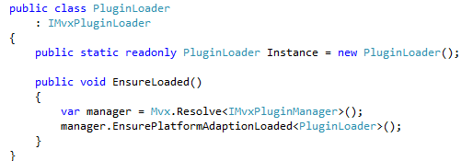
A Vibrate plugin
Core - PCL:

Slide 3
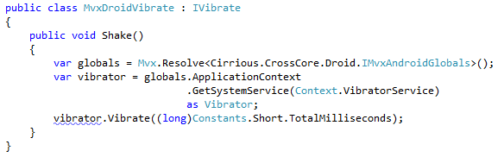
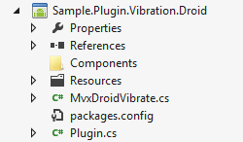
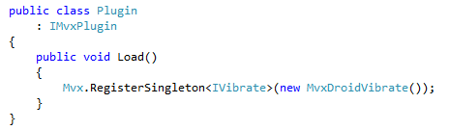
A Vibrate plugin
e.g. Droid Adaption:

Slide 4
General Plugins
Plugins are just a wrapper around IoC
NuGet makes them very easy
NuGet also allows inter-Plugin dependencies
You can have many interfaces in 1 Plugin

